Slide 1
Query Processing and Data Aggregation

Slide 2
Energy Consuming Parts of Sensor Network
Sensor Transducer
Responsible for capturing environmental parameters
Samples measured physical data and converts them into electrical signals
Embedded Processor
Equipped with memory and responsible for controlling the sensing, computation, and communication units
Two types of energy consumed in this component: switching energy and leakage energy.
The switching energy is consumed when computation is performed
The leakage energy is consumed when no computation is being performed.
Transceiver
Consists of a transmitter for sending data and a receiver for receiving the data from its 1 - hop neighbors.
Energy is consumed for both transmitting and receiving data

Slide 3
Spatial Property: The physical parameters sensed by neighboring sensor nodes are similar in nature.
Temporal Property: A sensor node may sense similar data values during consecutive time periods
Remove or reduce the redundancy and transmit the relevant data to the BS or sink.
The process or technique of reducing data redundancy by combining the data from neighboring sensor nodes is called data aggregation
A user requests the BS for relevant information in the form of queries
Two types of routing the data back to the BS
Address–Centric (AC) routing
Data- Centric (DC) routing

Slide 4
Query Characteristics
Types
Query Request
Query Response
Structure of Query
SELECT … FROM … WHERE … GROUPBY … HAVING …
join, projection, aggregation, grouping
Sensor Data → A virtual table with one column per sensor type
Tuples are appended at well-defined intervals
Time between sample intervals → epoch
Every sensor query is associated with time interval [S, S+T]
Query Operators
Types of data: Stored data → relation; Sensed data → sequence
Sensor query is defined as an acyclic graph of relational and sequence operators
Relational Operators: insert, delete, modify
Sequence Operators: insertion of new record

Slide 5
Query classification
Frequency of Query Response
Historical Query – used for analysis of historical data
One-time Query – instantaneous → only one response → same start and end time
Persistent Query – monitoring for a continuous period → start time “now”, end time “infinity”
Nature of Search Space
Spatial
SELECT attr_val FROM sensor WHERE loc = (20, 30).
Temporal
SELECT attr_val FROM sensor WHERE time = 6:50 am – 2:30 am
Spatio-Temporal
SELECT attr_val FROM sensor WHERE loc = (40, 25) and time = 1:30 pm – 4:30 pm

Slide 6
Semantic Nature of Query Response
Exploratory Query
Return the record on 01 18 - 07 at5:00 pm
Monitoring Query
Return all records for 01 - 18 - 07
Range Query
Return all days in the month of March when only fan number 1 was on
Range of Data in Query Response
Filtering Query
Non-filtering Query
Number of Attributes in Query Request
One-Dimensional Query
Multi-Dimensional Query

Slide 7
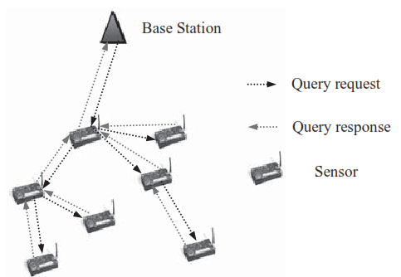
Challenges in Query Processing
Query Broadcast
Single query vs. fragmented query
One-to-all or level-wise forwarding
Identifying duplicate queries
Aggregated data vs.
individual data
Querying Interface
Efficient DB for Querying
Uncertainty and Transience
in sensor readings
Probabilistic queries and answers

Slide 8
Sensor Selection for Querying Process
Types of sensors
Temperature sensor
Light sensor
Pressure sensor
Sensor ID, location, timestamp, value of the reading
Sensor selection using
Group By
Having
Where
Join
Specific region
Specific periodicity

Slide 9
Query Processing Techniques
Warehousing Technique
Processing of sensor queries is kept completely separate from the access to the underlying sensor network, where the actual data is sensed and stored.
Involves two processing steps
Data is extracted from the sensor network in a predeﬁned fashion
Stored in a centralized database located on a unique front-end server.
Suitable for processing predeﬁned queries over historical data
Distributed technique
The query workload determines the data that should be extracted from sensors.
More ﬂexible because it enables different queries to extract different data from the sensor network.
More efﬁcient because only relevant data are extracted from the network.
Efﬁciently utilizes the computing resources on the sensor nodes. The sensor query in this case can be evaluated at the front - end server, in the network itself, at the sensors, or at some mixture of the three.

Slide 10
Query Flooding
Full flood
Answer to the query is guaranteed to reach the originator
Each node floods the query to all the nodes within its radio range
Causes unnecessary communication overhead
Variation: Contact only a fixed set of nodes that are relevant to the query within a predefined spatial window → reduces congestion thereby reduces response time

Slide 11
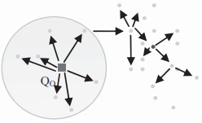
Full Flooding

Slide 12
Spatio-Temporal Window
Two processing phases
Phase 1:GREEDYDF phase
Path is found to a node inside STWin for a given query originator (Q_{o}) that can assume the role of query coordinator (Q_{c}) to broadcast the query to all potential sensor nodes
Route the packet to its neighbor that is closest to Q_{c}.
Optimal location of Q_{c} is the center of STWin
Does not assure the establishment of a routing path within STWin
Phase 2:
WinFlood: When a node within STWin receives a query, it broadcast the query to all nodes both inside and outside STWin. Flooding stops when the query reaches a node outside STWin
WinDepth: Employs DFS traversal to individually send the query to the neighbors within STWin only if they have not yet received the query.
WinFlood is more cost effective since cost of single broadcast is lower than multiple point-to-point messages

Slide 13
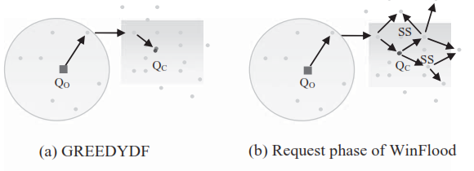
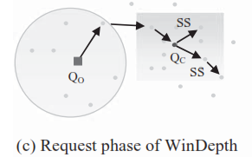
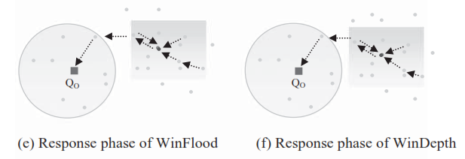
Spatio-Temporal Window

Slide 14
Directed Diffusion
The data is identified by an attribute value pair
The query response is data centric
The dissemination sets up a gradient which draws the event data toward the disseminators of the queries.
Gradient is specific to the value of the data wanted and the direction in which the data needs to be sent.
Eg. Query: type=temparature, interval=10ms, duration=40s, Rect = [-200,200,400,600]
DD exploits the spatio-temporal correlation
More applicable for dense, static sensor networks
Not suitable for mobile sensor networks

Slide 15
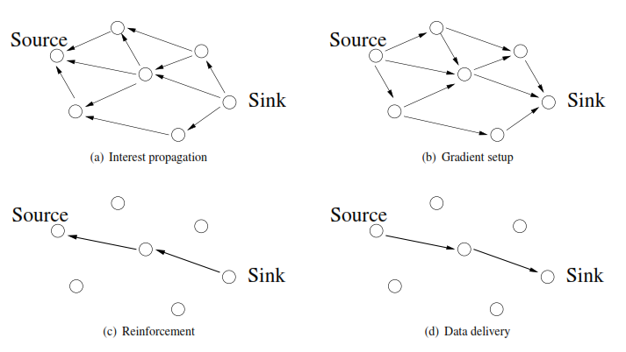
Directed Diffusion

Slide 16
Snapshot Querying
Not all sensors respond to query
Only preselected nodes are allowed to respond to a query
In case of node failure, the surplus standby node responds for the query
The location and values of the representative nodes present the picture of the value distribution in the entire network
Example:
After receiving a query the neighboring nodes synchronize on a localized basis to select a set (R_{N} )of representative nodes for answering the queries.
The node N_{i} with largest number of neighboring nodes is selected as a representative node and in case of tie largest id will be selected.
If N_{j} fails or goes out of range of other sensors N_{i} act as the representative of N_{j} if d(x_{j}, x_{i}) <= T, where d can be relative, absolute, or sum squared error and T is a pre-specified threshold.
N_{i} obtains the reading of every neighbor node N_{j} either by full flooding or periodic announcements.
If Ni does not respond or if d(x_{j}, x_{i}) > T then N_{j} selects new representative node
Each node N_{i} maintains a cache line that is updated by cache admission and replacement policies

Slide 17
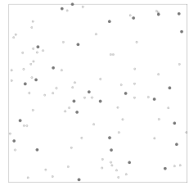

Slide 18
Time Series Snapshot
Used for historical queries like
Find average humidity in a region1 for the years 1989 to 1994.
The monitored region is partitioned into a set of sub-regions and the value distribution in each sub region is bounded by a predefined range of the attribute value
The readings from sensors located closest to the borders of all sub regions are obtained
The sensors at the surrounding area of boundaries need not transmit data and thereby reduces overall energy consumption

Slide 19
Acquisitional Query Processing
When and where data should be sampled and how often the sampling should be done.
Query optimization
To optimize query in terms of cost, time, and power involved in retrieval
Cost of acquiring a result per second is directly proportional to the cost of executing the query
Cost of retrieving a reading from a table of query plans is inversely proportional to the selectivity of predicate (: the fraction of rows selected from the table by the predicate if the condition Is satisfied)
Approaches : Binary Decision Tree, TinyDB

Slide 20
Binary Decision Tree Approach
A binary decision tree is built on a conditional plan (P_{Tj(x)}) which splits the plan at an internal node n_{i} into two alternate condition plans T_{j}(x)=T and T_{j}(x)=F
Expected cost of the plan P is the sum of the cost starting from the root node and the expected cost of the value of each new predicate T_{j}

Slide 21
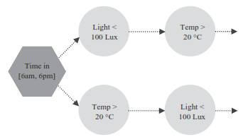
Conditional Plan based on time of day

Slide 22
TinyDB Approach
Uses distributed query processor in each node of sensor network
TinyDB incorporates acquisitional techniques and runs on top of TinyOS.
TinyDB consists of tuples where each tuple denotes one row per node per instant in time with one column per attribute
Queries in TinyDB is of the form SELECT-FROM-WHERE-GROUPBY
Eg. SELECT node-id, pressure, humidity FROM sensors, SAMPLE PERIOD 5s FOR 40s

Slide 23
Data Aggregation in WSN
Challenges:
Energy Efficiency: sleep scheduling protocol
Timing Control: within reasonable time bound
Application Orientation: based on app. summary, data compression etc. may be used
QoS Support
Data Aggregation Techniques
Energy efficient Data Aggregation
Neural network based Data Aggregation
Delay Constrained Data Aggregation
QoS Constrained Data Aggregation
Data Aggregation for Range Query
Structure free Data Aggregation

Slide 24
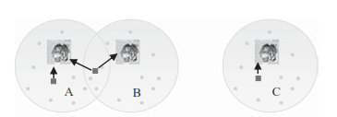
Energy Efficient Data Aggregation
Use of simple mathematical operators
Provides estimated value of the population
SUM, COUNT
Gradual aggregation when the data goes up along the tree.
Aggregating Object Report at Source
Aggregate at the source and send the report back to BS.

Slide 25
Neural Network Based Data Aggregation
By using dimensionality reduction
Achieved by employing neural network based algorithm which runs on an iterative pattern of adjusting weights to learn regular inputs.
Instead of reporting raw data, specific sensory input pattern is classified and is sent
FuzzyART (Adaptive Resonance Theory)
The input layer F₀ stores input bits and transmits it to category layer F₂ via comparison layer F₁
Each input pattern is compared with each category node n_{i} and an activation T_{i} is calculated for each category node. The node with maximum T_{i} ‘s weight is compared the input at F1. If the matching condition satisfies a threshold (ρ), then n_{i} captures the current input and updates its weight.
The comparison cycle continues until a stored category is found matching the input pattern. If not the network learns a new category by assigning a new category node in F₂.

Slide 26
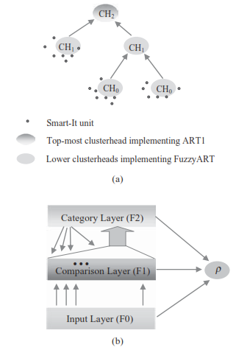

Slide 27

Es – energy savings in communication
n – No. of sensors in cluster unit
k – No of sensors reporting to CH
r – size of raw sensor data
c – No. of bytes to represent a category

Slide 28
Delay Constrained Data Aggregation
Timing control problem due to delay incurred in collecting data from neighborhood
Data Aggregation Tree (DAT) based approach
Different tree nodes respond to a query with different delays depending on the tree levels at which they are located.
To reduce delay
FSM based feedback control scheme
Waiting time at each level of tree is adjusted according to the output of FSM while maintaining substantial level of accuracy
Initial part of FSM waits for larger time.
When accuracy level reaches a stable value, the waiting time is adjusted to control delay.

Slide 29
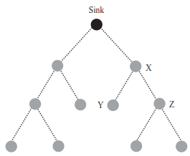

Slide 30

Variants of FSM based scheme
At each step of calculation in the aggregation period, the optimal number of messages received is compared with the actual number received. If fewer messages are received, the aggregation period is increased by one unit. Otherwise decreased by one unit
Change the parameter to the performance and based on the difference between the actual number of received responses and the desired optimal number of responses.
This decision is made based on whether the aggregation period needs to be changed at a faster speed, instead of the addition/subtraction operations at the FSM.
Data responses are sent bottom - up starting from the leaf nodes to the sink. Each data response contains some extra information, indicating the total number of responses that have been aggregated into a single message.
Based on this information, the next aggregation period T_{n+1} is calculated as

Slide 31
QoS Constrained Data Aggregation
Sending reports to BS is deferred to meet
End-to-end latency
Measurement accuracy
The intermediate nodes independently decide whether or not to perform data aggregation based on resource conditions and task requirements
No clustering or tree formation is required
When and where to perform the task is based on availability of local information
If the QoS requirement for end-to-end delay is at most D, but the packet received at intermediate hop already exceeded the constraint, the packet is discarded
Three cases upon receiving a packet
If the delay constraint can be satisfied, the intermediate node (aggregator) defers the report for a pre-specified time interval with a pre-specified probability, during which it processes and aggregates any packets that arrive and generates a new packet before transmitting it to the next hop.
If the delay constraint can be satisfied only if the report is not deferred, the aggregator tries to forward this report to the next hop.
If the delay constraint cannot be satisfied in any case, the aggregator discards the report to avoid further wasting of any additional resources.
Trade off between Energy efficiency, Delay requirement, accuracy and buffer overflow probability
Packet Delivery Probability higher with discard strategy
Energy consumption decreases as deferred time increases
Network lifetime increases
Reduced comm. Due to increased aggregation
Average delay increases

Slide 32
Data Aggregation for Range Query
Combines data aggregation and dissemination
Network consists of
mobile sinks which request nearby static sensors to sense event data,
specific sensor in a grid, which has knowledge about the event, is designated as the head of the grid.
For a regular - shape range query, a mobile sink designates the range (e.g., a range of rectangle) for data aggregation, and requests the source (i.e., a static sensor sensing data) to collect the data in the designated range.
The head of the grid, called agent, receives the aggregated data from the source and sends the data to the mobile sink.
The aggregated data from a source, which are a collection of packets reported to all the children of the source, are reported to the nearby head of the grid.
To account for its mobility and to ensure that the mobility does not affect the data transmission, a mobile sink receives data from the source constantly.
It checks its location every second and if it detects that it moves out of the original grid, it chooses the head of the new grid as a new agent.
An irregular - shape query is used to monitor and collect the data of the diffusing event, that is, the event data from another neighbouring grid that may diffuse into the grid in question.
A cache mechanism is used to resolve the identical queries issued from mobile sinks. The protocol can reduce the overall energy consumption of the network.

Slide 33
Structure-Free Data Aggregation
Maintaining hierarchical structure introduces additional cost, in case of mobile sensor networks
In a dynamic environment, mobile sensors may frequently go out of the transmission range and a new structure needs to be built more often, leading to high maintenance overhead. This problem may also arise if a static sensor in the hierarchical structure runs out of energy and disconnects the topology.
Opportunistic (OP) aggregation: Data packets are aggregated only if they happen to meet at a sensor at the same time, which leads to inefficiency in the aggregation process.
In the OP approach, there is no pre-specified set of aggregation nodes for combining the data, which leads to last minute routing decisions to be taken and thus becomes time consuming.
To alleviate both problems, a structure - free data aggregation approach is proposed
To increase aggregation efficiency, a MAC protocol called data - aware any cast (DAA) is also proposed because packets need to be aggregated early on their way to the BS.
If some nodes wait for other nodes to send data it can lead to efficient aggregation. Hence Randomized waiting is used.

Slide 34
Conditions for Data aggregation
Spatial Convergence
Temporal Convergence
DAA improves spatial convergence and RW improves temporal convergence
In DAA
An independent set among sources is created
Nodes are assumed to be synchronized in time.
All nodes aggregates at the same time
Nodes in independent set act as aggregator and are created on the fly when data is transmitted to BS
Reduces extra overhead in structure creation
Each packet has aggregation ID (AID) used as the metric for aggregation
Uses RTS/CTS and anycast mechanisms in MAC
RTS contains AID and any neighbor with same AID responds with CTS.
Those packets are aggregated
To achieve temporal convergence Random Waiting is used
RW introduces artificial delay at the sources and thereby increases temporal convergence.
DAA + RW outperforms OP

